Slide 1
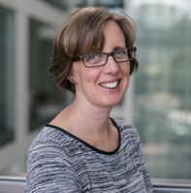
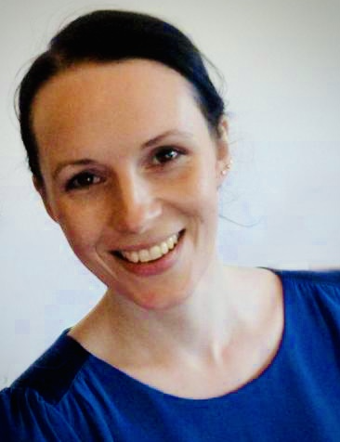
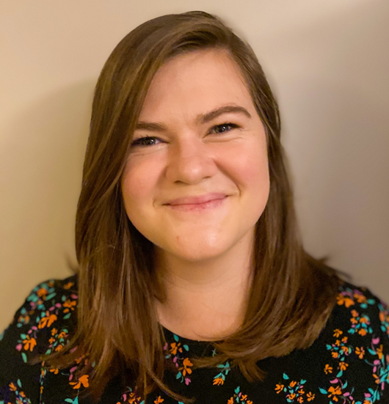
North East London AHPs Deliver Celebration Conference
Strengthening and Promoting the AHP Community
Forging pathways and strengthening the AHP community in research:
Sharing stories from three early career Clinical Academics
Sally Morgan¹, Freya Sparks^{1,2}, Kirsten Prest^{1,3}
1 City, University of London School of Health and Psychological Sciences; 2 Barts Health NHS Trust; 3 East London NHS Foundation Trust
OUR JOURNEYS
Sally Morgan
BMedSci
(Speech Science)
Clinical development training
Management course & NHS life coaching
MSc Psychology
& Health
PG Cert
Academic Practice
Barts Charity
PhD
NQT -> 8a highly clinical specialist SLT
Audits & clinical questions
Own children starting school – what next?
Lecturer role City, University
More clinical questions
Freya Sparks
PgDip Speech and Language Therapy
MRes Clinical Research
NIHR pre-doctoral bridging scheme
RDS Enabling Involvement fund to support PPI
Barts Charity
PhD
Clinical work as an SLT and Research Assistant
Clinical work to develop experience, research interests and networks
Identified academic and clinical supervisors to support doctoral app
Kirsten Prest
BSc Occupational Therapy
Masters in Evidence-Based Healthcare
Conference presentations and project collaborations
Identified a potential PhD through collaborations
HARP
PhD
Clinical work in South Africa & UK prompted research interest
Familiarised myself with relevant literature
Reached out to researchers on Twitter
Prepared application with supervisor support
COMMON THEMES
Research is Accessible
Slow and Steady Wins the Race
‘My first writing was an ‘In the Journals’ 100-word piece in the RCSLT Bulletin’’
"I took part in research as a participant first"
‘I began to ask research questions in my clinical work’
‘Looking back, I’ve had a career river’
‘If you’re trying to have a clinical academic career, it is going to take longer because you’re trying to do two things’
’‘Submitting an abstract was not so scary once I got going
‘Your clinical and research work can inform each other’
‘The time between my Masters and PhD was valuable’
‘You could start by being research interested instead of research active’
‘I went from audits and service evaluations to my first small research project’
‘I used to worry that time was running out, but now I realise there is time because the road is long’
‘Take the time to find out what interests you and makes you curious’
Networks and Support
Funding
‘Joining clinical specialist interest groups was great for developing research ideas’
‘I found my research supervisor through Twitter’
‘Barts Library was a great resource for me’
‘I considered funding from the Elizabeth Casson Trust as an OT’
‘I applied and wasn’t successful to Bailey Thomas Foundation and a City studentship before I was finally successful’
‘I reached out to researchers from other professions’
‘I’m funded by HARP which is a new scheme for all health professionals’
‘I’m funded by Barts Charity’
‘There are many smaller schemes which can help you in your journey’
‘Joining groups like CAHPR helps connections’
‘I went looking for AHP clinical academic role models so that I felt less alone’
‘Don’t be afraid to look beyond NIHR’
Notes:
‘Submitting an abstract was not so scary once I got going’
"I took part in research as a participant first“
‘You could start by being research interested instead of research active’

