Slide 1
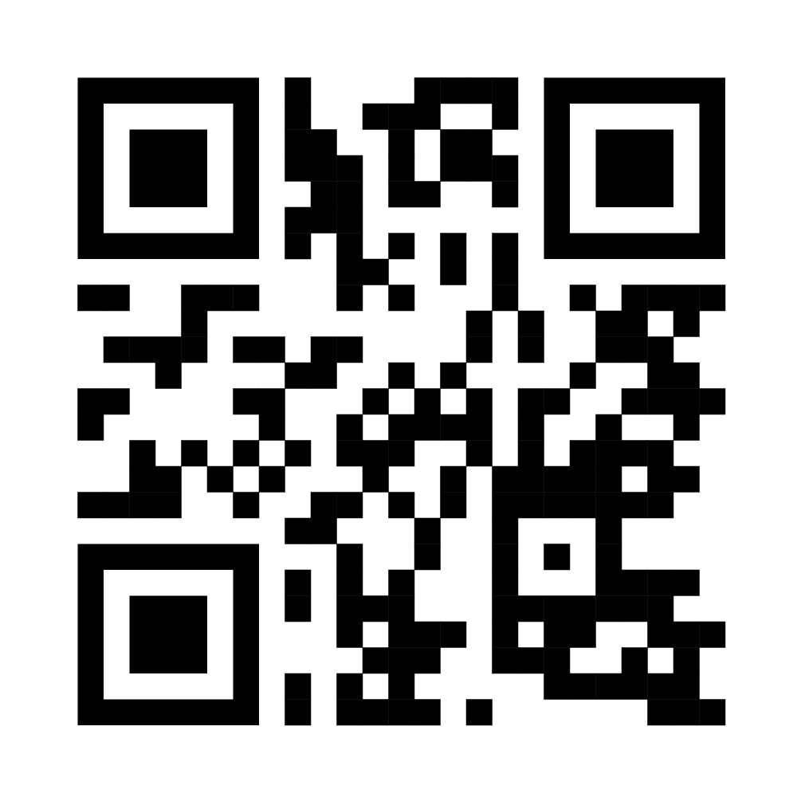
The SEEM Study: Safe Efficient and Enjoyable Mealtimes:
Creating a toolkit for families of children who need assistance with eating and drinking –
an observational study protocol
Morgan, S.¹, Weir, K. A.² , Mulligan, K.^{1,3} , Hilari, K.¹​ ¹City, University of London, UK, ²University of Melbourne , ³East London NHS Foundation Trust, UK, Sally.morgan.2@city.ac.uk @sallymorganslt
Objectives
Explore whether parents who provide mealtime assistance to children with neurodevelopmental dysphagia can identify signs of oropharyngeal dysphagia & their response
Explore parents’ & children’s experiences and decision making, during mealtime assistance, including barriers and facilitators to following mealtime recommendations
Planned methods & data analysis
DATA COLLECTION
DATA
ANALYSES
SLT recruitment process & information
10 parent-child dyads.
School aged (5 - 15;11 years)
Neurodisability
Oropharyngeal dysphagia
Require mealtime assistance
Child & parent information forms
Descriptive statistics of participants
Content analysis: Behaviours targeted & techniques used
Determine parental adherence to mealtime recommendations
Current mealtime recommendations
Video 1: Parent-child mealtime view
Describe parent-child interaction
Parental response to signs
Mealtime visit (Session 1)
Informed parental consent received
Child agreement provided
Determine auditory aspirating vs non-aspirating swallows
Determine if swallow sounds and video clinical signs correlate
Audio 1: Neck microphone swallow sounds¹
Video 2: Close-up child mealtime view
Determine clinical visual & auditory signs of aspiration/dysphagia
Video 3: Child’s view brief conversation
Dysphagia Disorder Survey assessment³:
Determine dysphagia severity
Video reflection visit (Session 2)
Thematic analyses of mealtime experiences &/or decision making
Audio 2: Parent video stimulated recall reflection & dialogue² session
Directed content analysis of enablers/barriers to adherence
Results & Discussion
References
UK HRA approval received. NHS Research Ethics Committee and Trust Research & Development approval awaited.
This is study 3 of the SEEM project which will create a mealtime recommendation toolkit for families of school-aged children who need assistance with eating and drinking.
[1] Frakking et al. (2016). The use of cervical auscultation to predict oropharyngeal aspiration in children: a randomized controlled trial. Dysphagia, 31, 738-748.
[2] Nind et al. (2018). Using video and dialogue to generate pedagogic knowledge: teachers, learners and researchers reflecting together on the pedagogy of social research methods. In The Teaching and Learning of Social Research Methods (pp. 117-132).
[3] Sheppard et al. (2014). The dysphagia disorder survey: validation of an assessment for swallowing and feeding function in developmental disability. Research in developmental disabilities, 35(5), 929-942.

